Slide 1
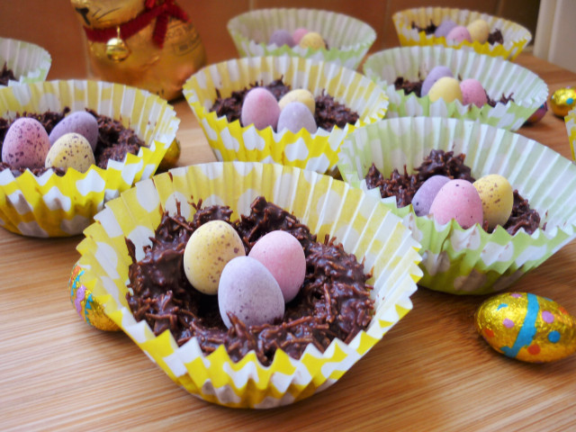
Shredded Wheat Chocolate Nests
By Marva

Slide 2
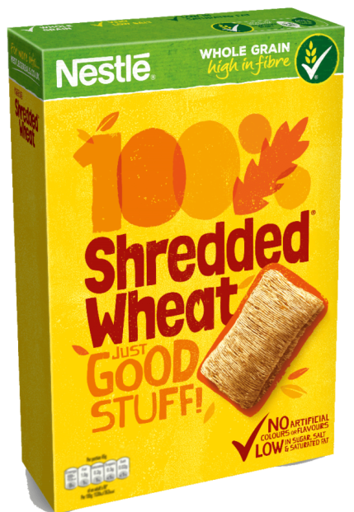
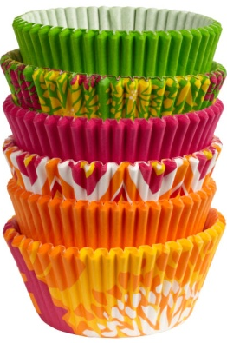
Ingredients
Paper cup cases
5 Shredded Wheat
400g milk chocolate
4tbsp honey
1 x 100g bag of Mini Eggs

Slide 3
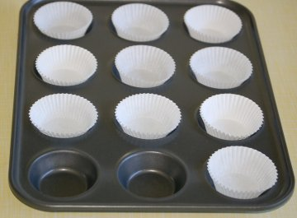
Place the paper baking cases into the hollows of the baking tray.

Slide 4
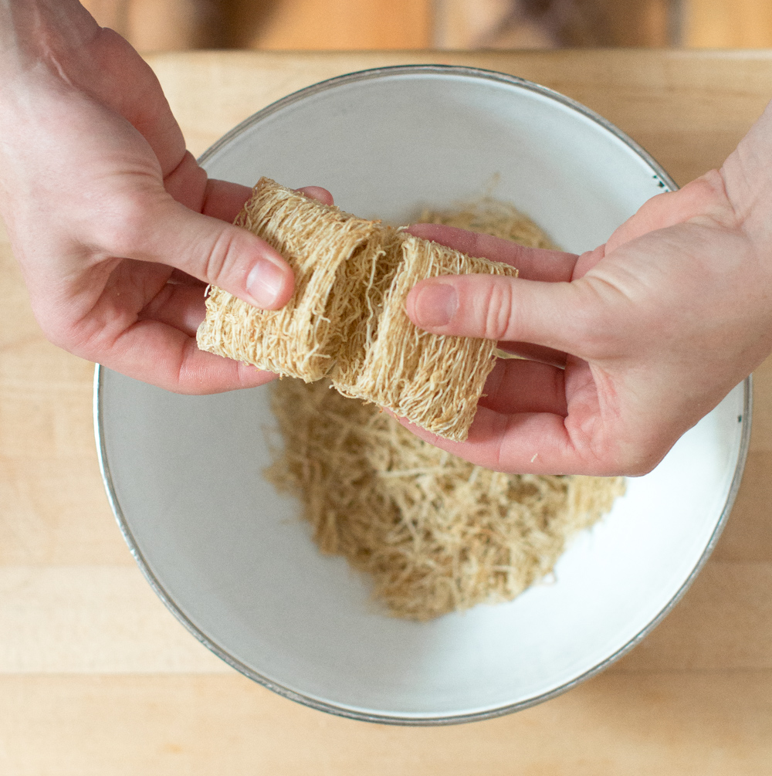
Gently pull apart the shredded
wheat bars .

Slide 5
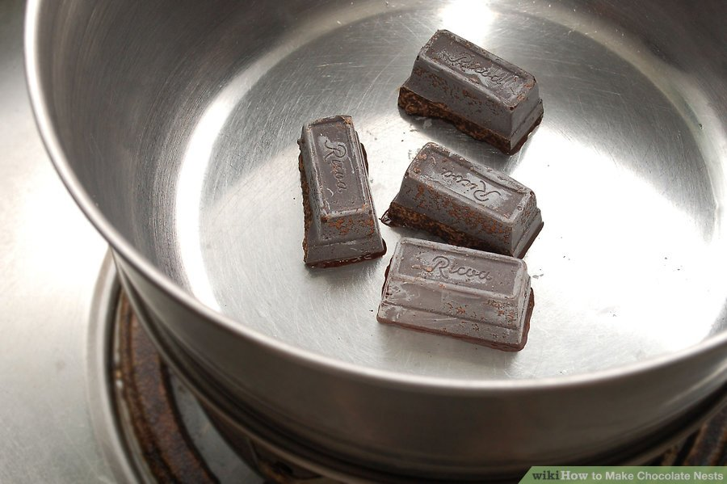
Break the chocolate into pieces and place these into a large bowl.

Slide 7
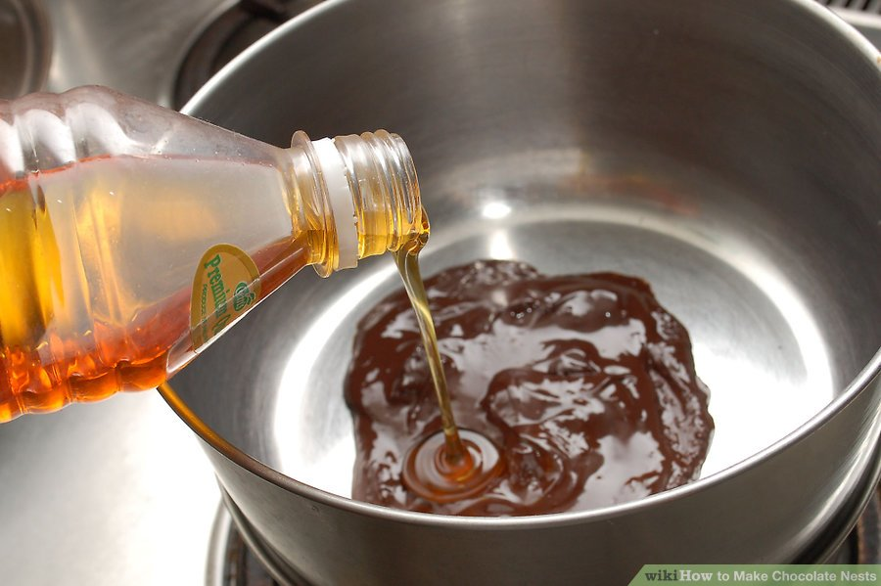
Add the honey.
Notes:
Dip a tablespoon into hot water to warm it up

Slide 8
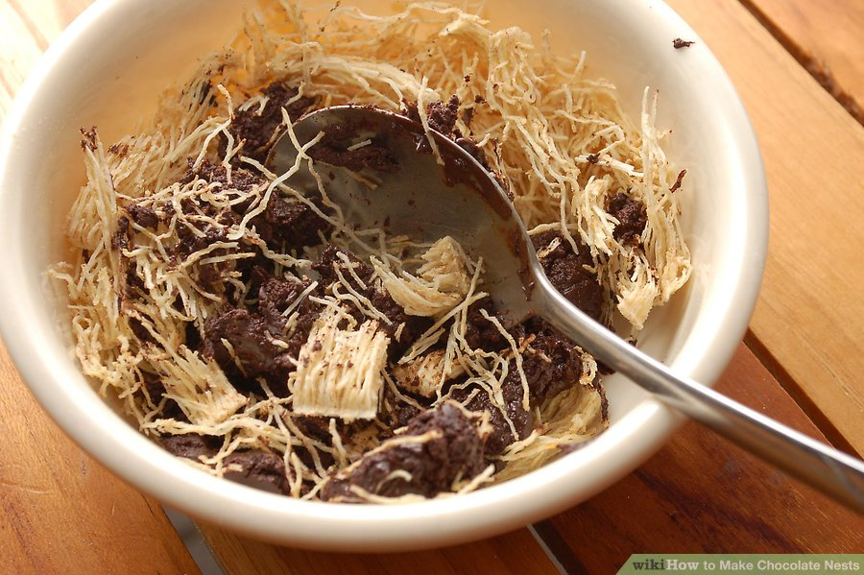
Add the shredded wheat to the melted chocolate.
Gently stirring them until they are covered with the chocolate.

Slide 9
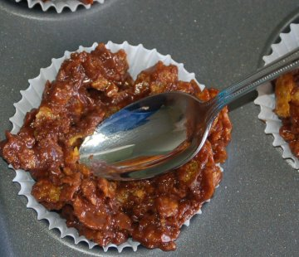
Put the mixture into each of the paper baking cases, making a small hollow in the centre of each nest with the back of a teaspoon.

Slide 10
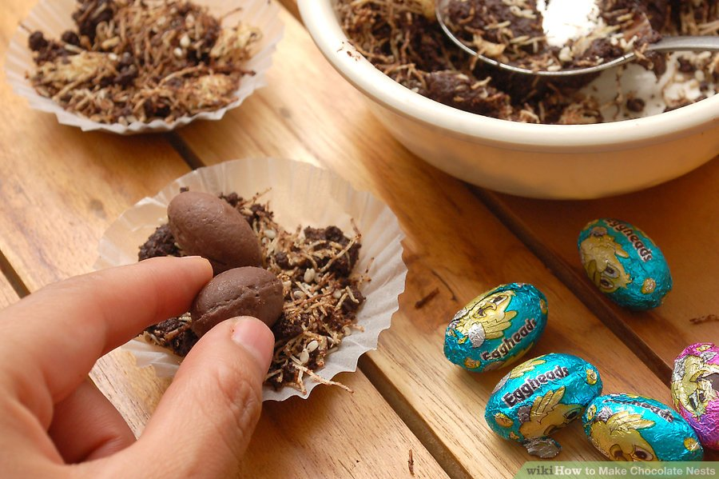
Place a few eggs in each nest.
Leave to set.

Slide 11
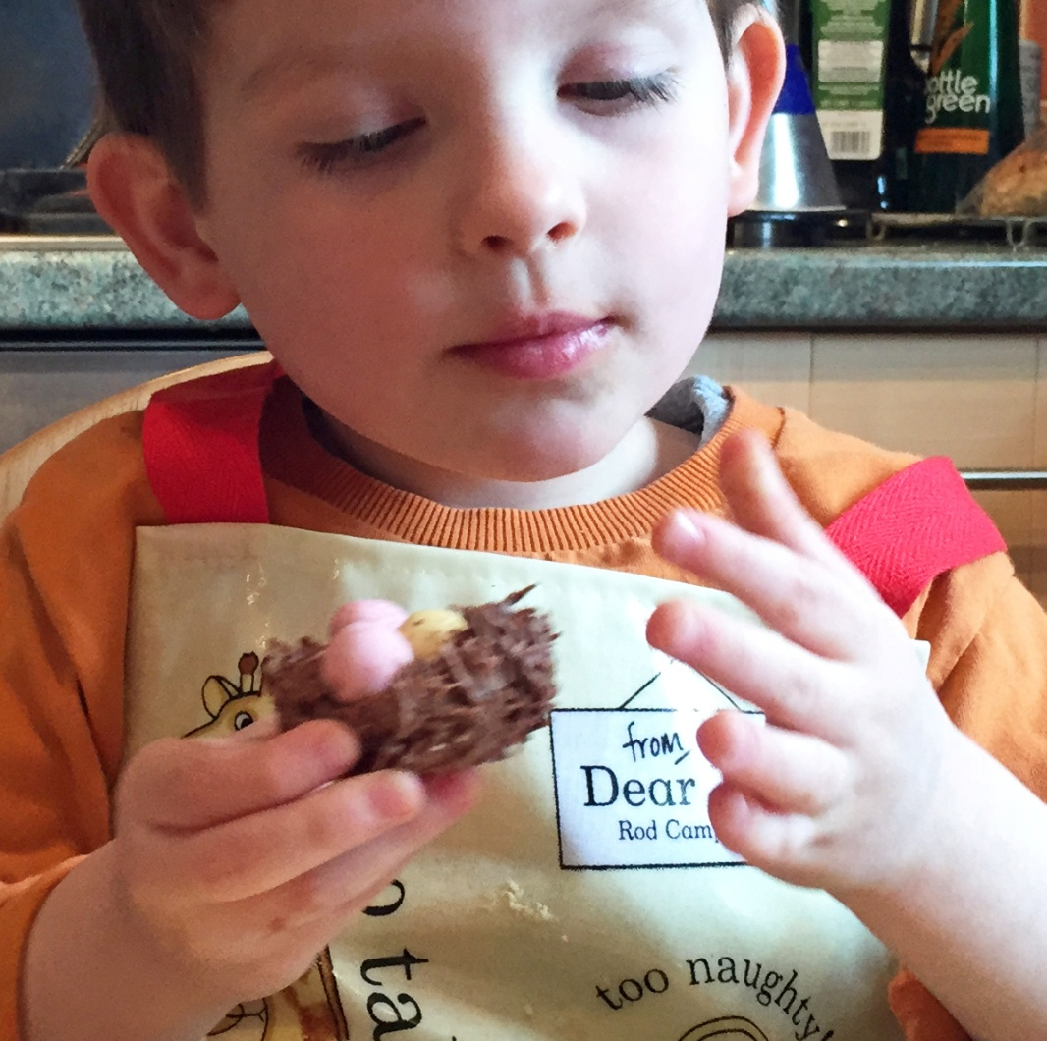
Enjoy!

